Slide 1
Low Quality News Identification
ROCARDO, Lin

Slide 2
Yahoo News Quality Dataset
658 news articles and manual labels from professional linguist or editor.
14 aspects of news quality. Including 'Fluency', 'Conciseness', 'Descriptiveness', 'Novelty', 'Completeness', 'Referencing', 'Formality', 'Richness', 'Attractiveness', 'Technicality', 'Popularity', 'Subjectivity', 'Positive Emotion', 'Negative Emotion', 'Quality'.

Slide 3
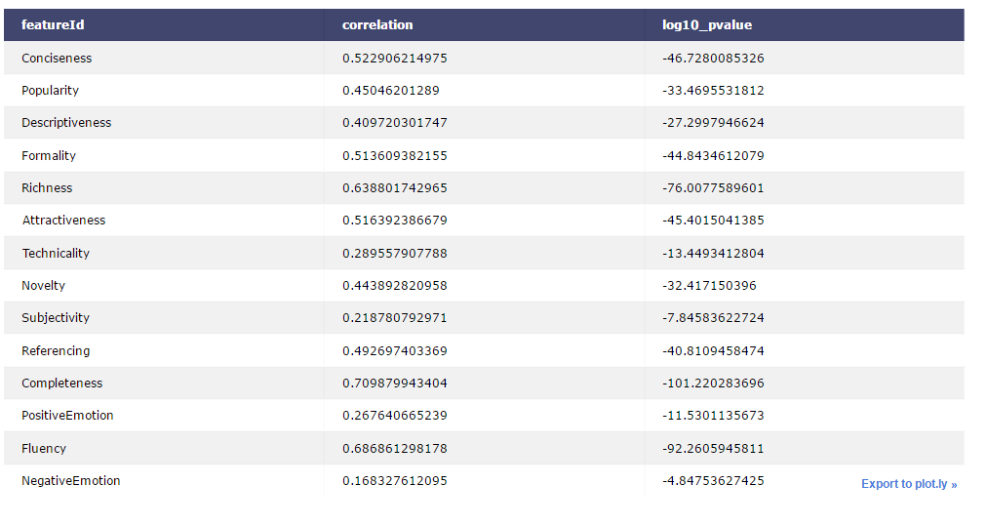

Slide 4
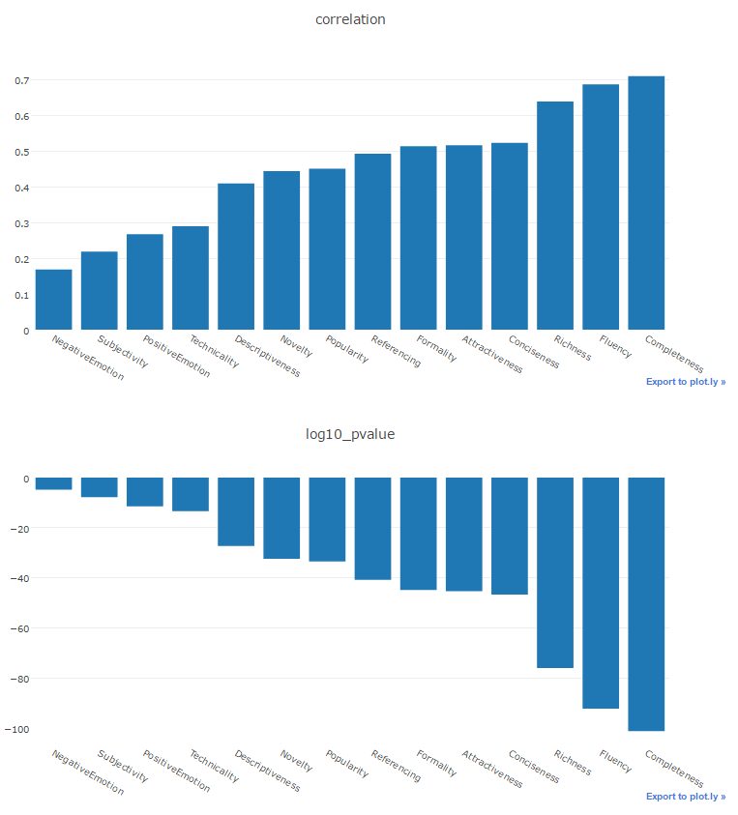
Correlation between attributes

Slide 5
CNN model details
First layer, embeds words in article content into low-dimensional vectors.
The second layer, performs convolutions over the embedded word vectors using multiple filter sizes.
At the end, max-pool the result of the convolutional layer into a long feature vector, added dropout regularization and classify the result using a softmax layer.

Slide 6
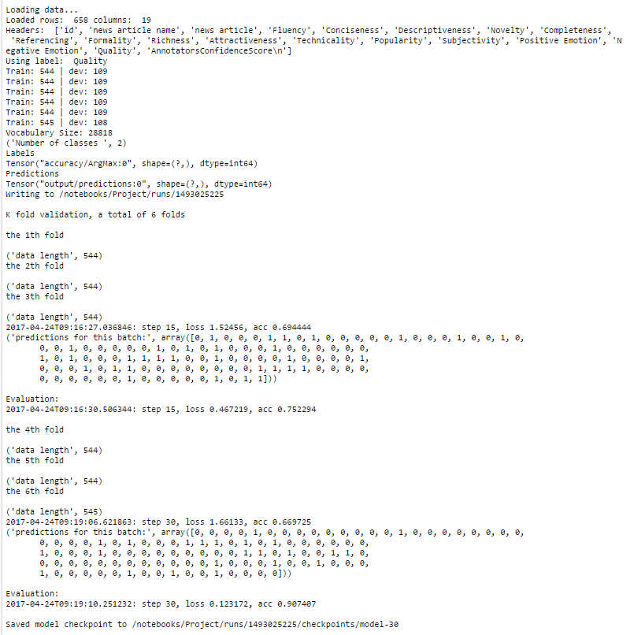

Slide 7
Model validation
6 fold cross validation on training data
Making sure model works on training data
Moving on to 159 Facebook articles that are labeled

Slide 8
Model training and evaluation

